Slide 1
Chill and Blaze: Ninja Rivals
2D game projected created in Solar2D
Victor Daniel Bucur
20211235

Slide 2
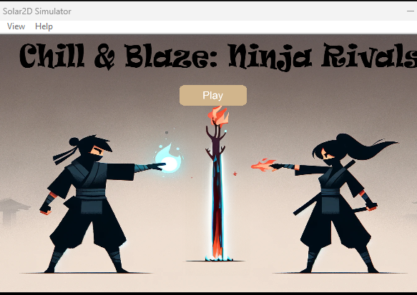
Introduction
There are two primary characters in the story, each possessing unique abilities. The female character wields the power of fire projectiles, while the male character commands frost projectiles.
The initial screen presents an image crafted in Photoshop, showcasing the two characters with a tree standing between them, frosted and burned at the same time. On top of its inserted a play button who redirects to the main game scene.

Slide 3
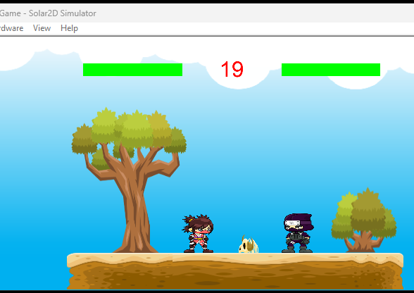
On the main scene we can see various elements :
Visual Elements:
Health Bars for each of the characters
Timer : if the timer goes from 30 to 0 the game will be Tie ( Game Over) and the game should be relaunched with CTRL + R
Objects like : Tree, Bush, Skeleton and a Platform ( made from 3 segments)
The 2 Characters
Audio elements:
Background music, Movement sound, Shooting projectile sounds and Explosion sound.

Slide 4
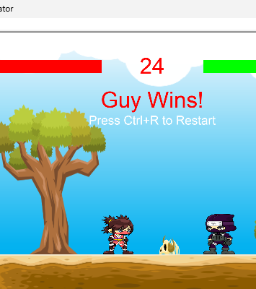
Game logic
The game follows a simple yet engaging logic, like every other fighting game. Two opponents face off, each possessing unique abilities and they must drain opponents' life by shooting with his projectile. The opponent have the option to get shot or jump over that projectile. The first player to drain their opponent's life completely wins the match. However, if the timer counts down from 30 to 0 or if either character successfully jumps and escapes the platform, the game ends in a tie, resulting in a draw for both players.
The movement is the following:
Girl moves with WAD and shoot with S;
Guy move with the ARROWS and shoot with Down arrow.

